Slide 1
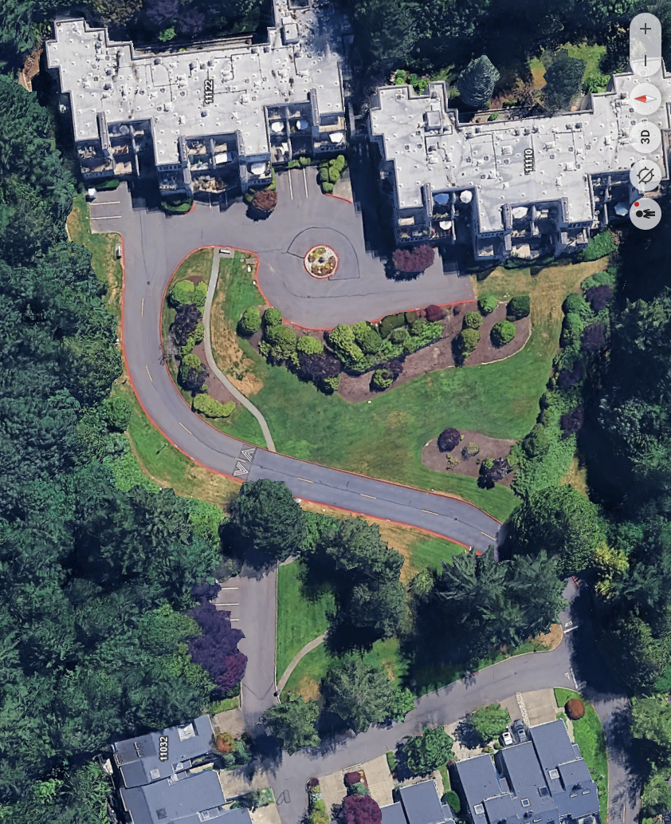
Irrigation zones for the Rainbird controller in PII
East
5
1). Large lower lawn area north to south
2). Large lower lawn area west of main drive from stop sign up to northwest corner of the North building
3). Upper large middle lawn south and west sides.
4). Upper large lawn North end .
5). Lawns East side of South building and planting beds.
6). Middle island bed and beds below or west of driveway.
7). Bed area base of large lawn and upper south end of large lawn.
8). Main entry beds and beds to the south and north of both buildings.
9). Beds on the right side or south of the main entry beds and the very south end of beds between parking drive and main lower large lawn.
10). Inner court area east side of South building (Drip pots)
11) is not working Mr. Rain said they need to replace a valve (east side of north building)
12 Inner court area east side of the North building (Drip pots)
A). Controller
A
8
8
8
6
7
9
2
9
North
4
South
6
6
4
3
3
3
2
2
2
1
1
1
West

